Slide 1
PROPERTY MANAGEMENT SYSTEM
NAME- 1) SAI SAMEER KUMAR LOLLA
2) SAIRAJ NAIK
3) ROUNAK NAIK

Slide 2
EASYHOMES
EasyHomes, is an online tool, for hassle free search of homes/flats/villas/plots for sale or for rent. You can also list your property for purchase/rent on this site. The site brings together the buyers and sellers under one roof, so that they can discuss among themselves and get mutually benefitted.
Cannot find that perfect house even after looking around all the city? At EasyHomes, we know that finding the perfect home can be time consuming and difficult. Sometimes you end up paying huge commission for agents, while other times, you take extra leaves for searching homes. We charge 0 fees for showing you the home of your choice. EasyHomes is a completely run by the community, for the community website.

Slide 3
You can also be benefitted by the ratings/reviews section so you can avoid that bad owner, who always interferes in your day. You can also chat on the numbers provided, for negotiations etc. If you feel satisfied, click on Make a Visit for full house details such as location on a map, house condition etc.
Have an empty house but cannot find anyone to rent or sell to? At EasyHomes, we also know that a To-let board in front of your house gives you no profit. List your house on our site for the world to see. You have the control who can see the location of your house or your profile. Just accept a visit request to give the client location access. Choose between renting or selling an accommodation.

Slide 4
We also give you the ability to search based on certain filters (e.g price, location etc.) and a team of developers are always there to listen to your queries/suggestions.
Moved in a new house and need help in moving your items from one house to the other? We can do that too for you. Visit the Packers and Movers section of our website, give details regarding the items, pick up and destination addresses and we will take care of the rest of the work.
A Home is more than bricks joined with cement. Find the perfect one for you today, only on EasyHomes.com

Slide 5
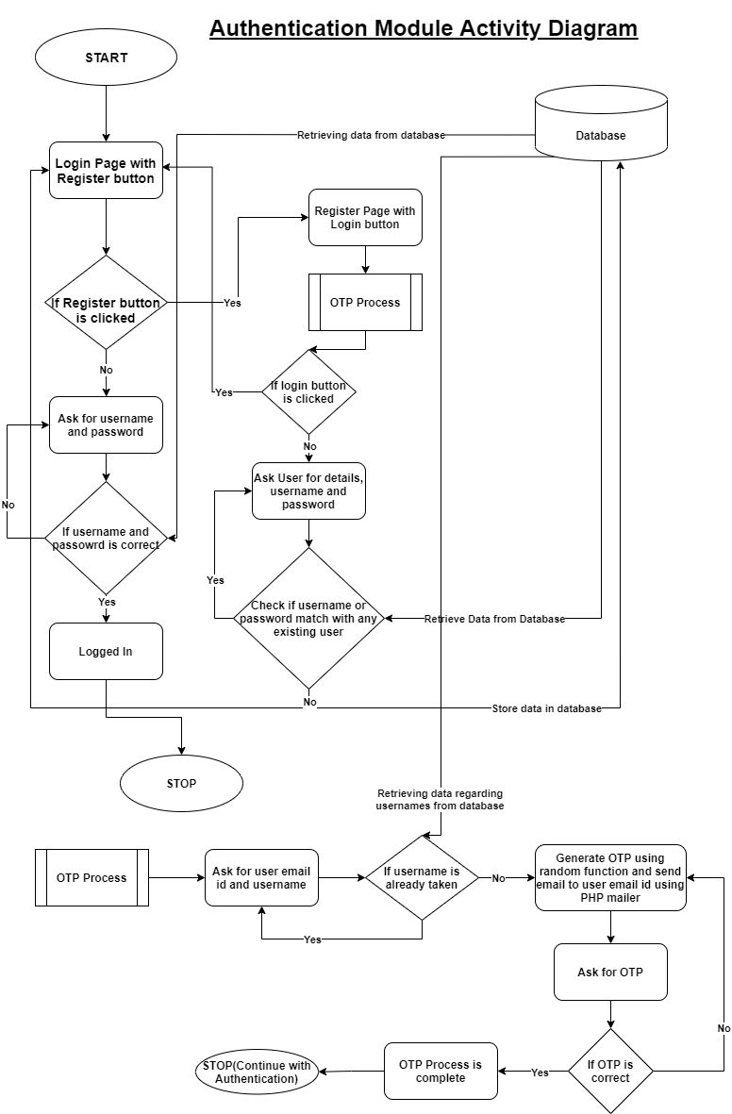

Slide 6
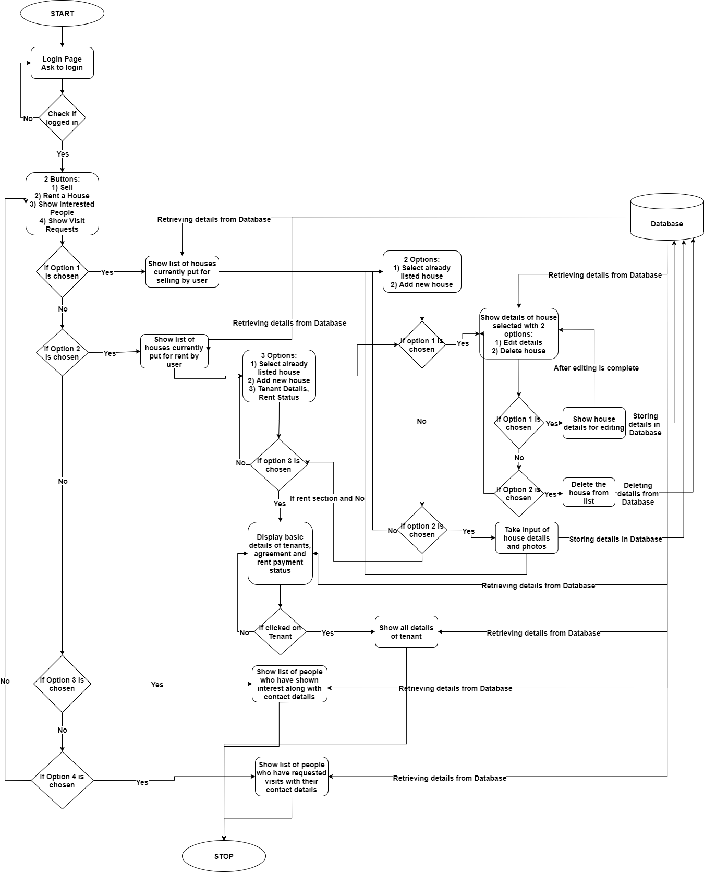

Slide 7
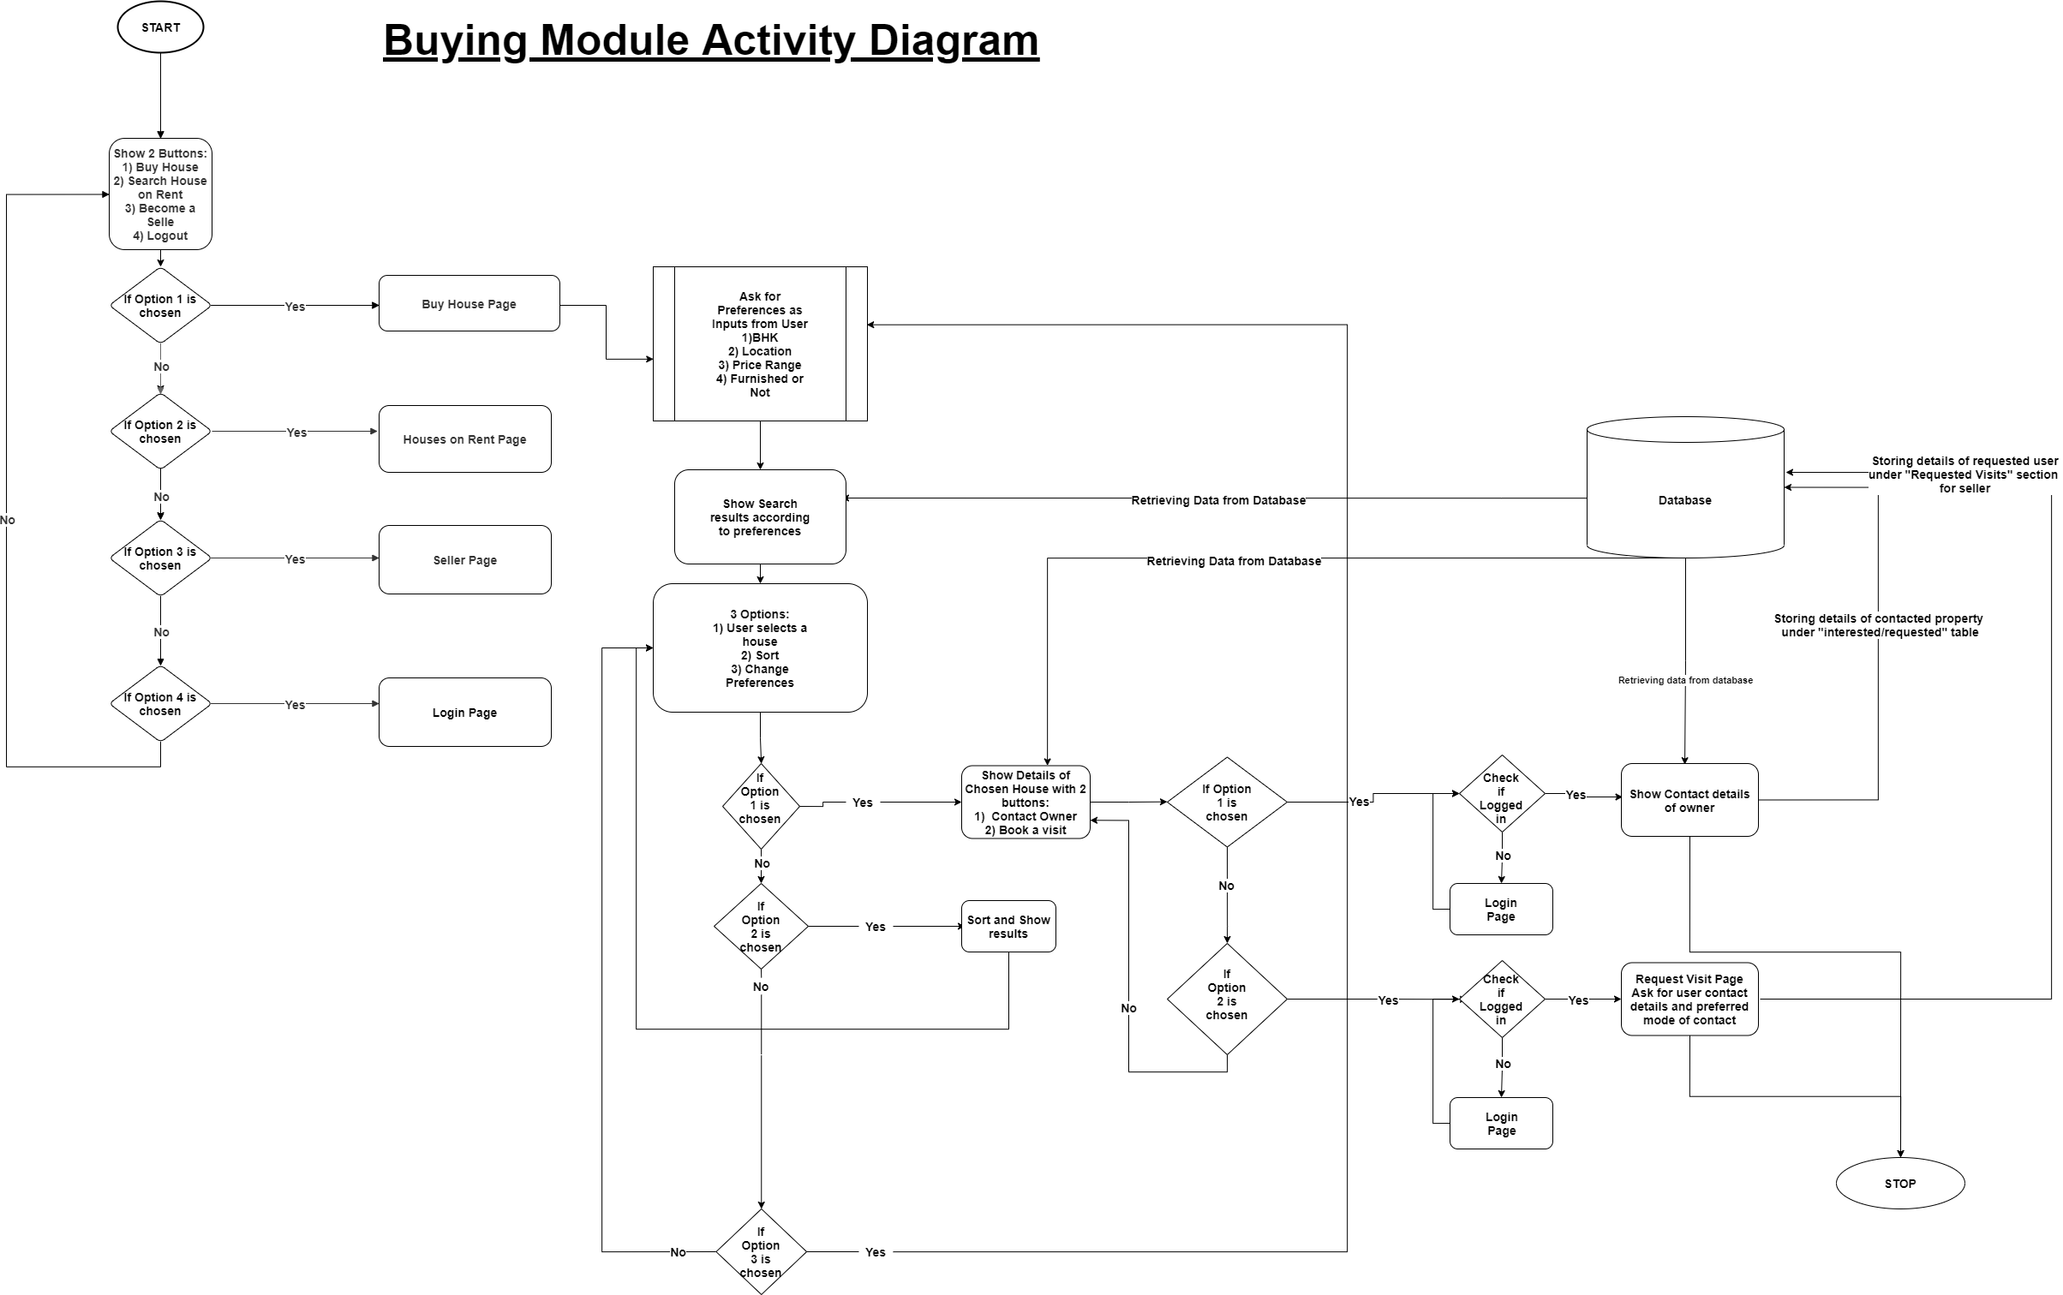

Slide 8
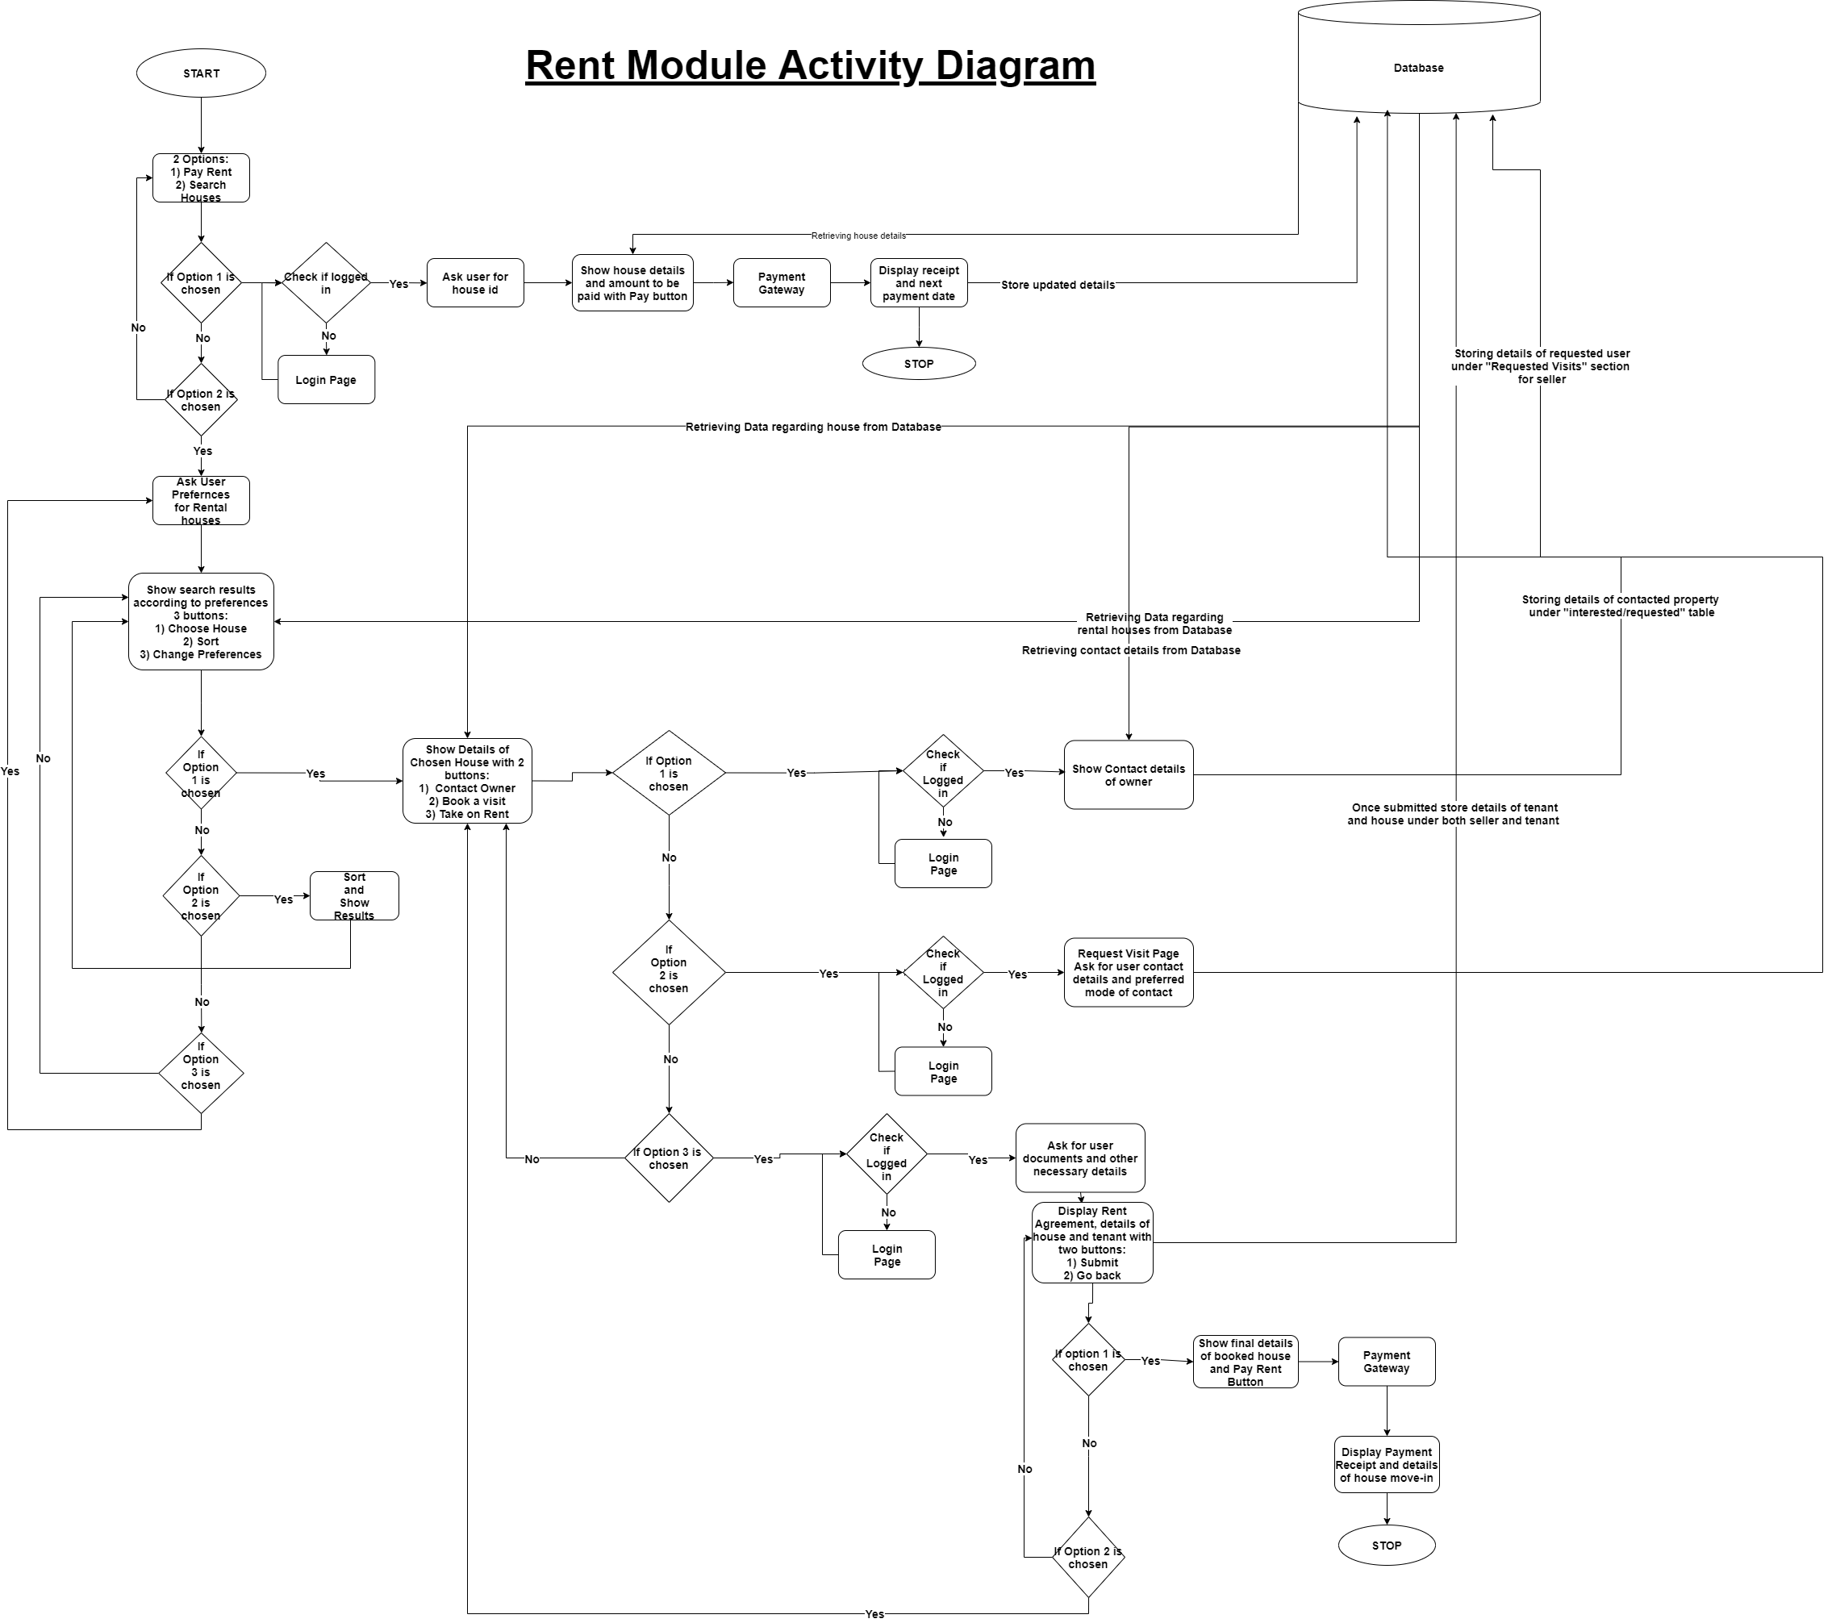

Slide 9
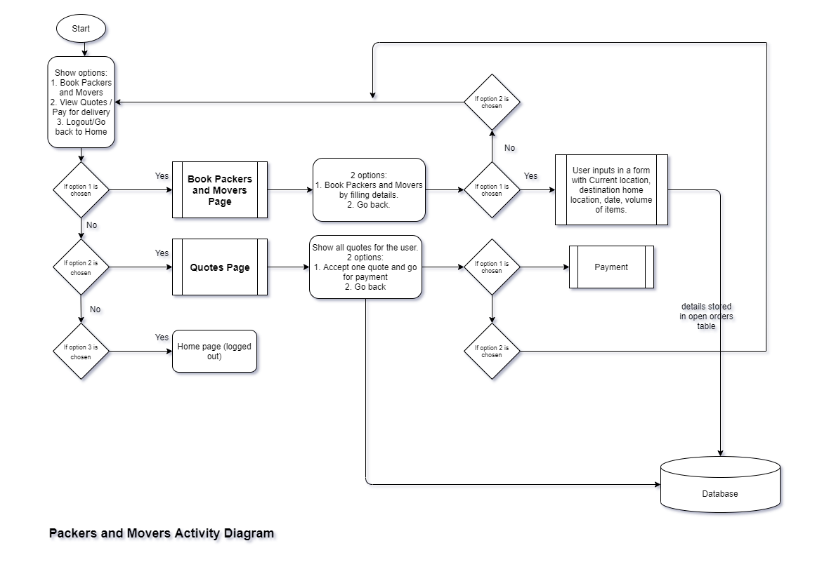

Slide 10
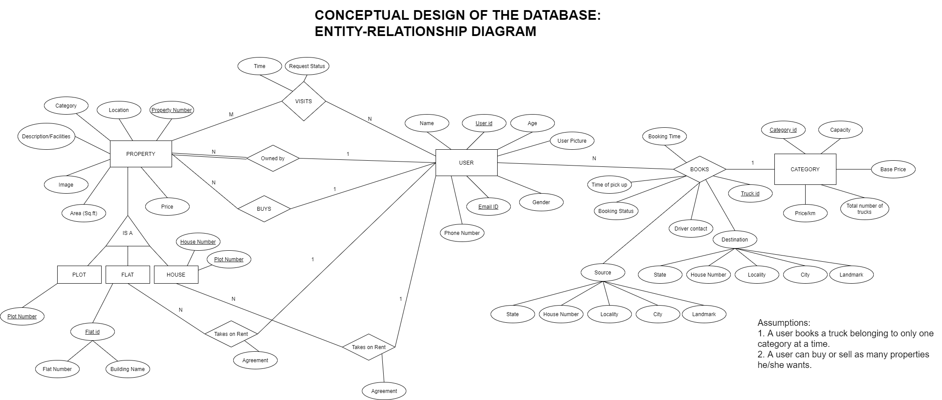

Slide 11
THANK YOU

